Slide 1
2nd digital presentation
Upskilling the EU workforce for hydrogen fleets and infrastructure operation and maintenance
*Funded by the European Union. Views and opinions expressed are however those of the author(s) only and do not necessarily reflect those of the European Union or the European Education and Culture Executive Agency (EACEA). Neither the European Union nor EACEA can be held responsible for them.

Slide 2
What is UPHYMOB?
As part of the EU’s Green Deal, hydrogen is foreseen to play a big role in the decarbonisation goals prescribed.
Large investments have been made in the sector in Spain, France and Germany, while more than 1 million jobs are expected to be created.
To the aim of supporting upskilling of EU workers to support H2 technology vehicles maintenance and refuelling systems infrastructure, UPHYMOB gathers intelligence and creates educational resources and tools tailored to the needs of the growing H2 mobility market.

Slide 3
Our progress so far…
In the past few months, we have focused on the gathering of data around the technical skills and theoretical knowledge required by the H2 mobility sector. Relevant information was gathered through online surveys with field experts, VET providers, researchers across the European Union, VET training provision hunting and identification and desk research on skills needs.
Research on existing fuel-cell mechanics training programmes provided a basis for the structure of the UpHyMob curriculum and reveal trends in skill needs for the H2 mobility sector.

Slide 4
In the past few months …
We researched H2 mobility sector requirements of technical skills and theoretical knowledge. How?
We surveyed:
field experts
VET providers
researchers across the European Union
We identified VET training provision
Research on existing fuel-cell mechanics training programmes provided a basis for the structure of the UpHyMob curriculum and reveal trends in skill needs for the H2 mobility sector.
We conducted desk research on skills needs.

Slide 5
Research and data gathering
Research protocol to gather skills intelligence in the H2 mobility sector
The consortium developed a research protocol in order to provide appropriate tools & guidelines for skills gathering, to identify skills needs, shortages and mismatches in the labour market of the H2 mobility sector:
Relevant information was gathered through:
Desk research (existing VET provision in partner countries, relevant studies and experts’ opinions on a European and national level)
Field research (online survey on a national level)
The research basis relies on European VET guidelines and ECVET principles to develop the learning outcomes, providing also clear references to the appropriate EQF level, so as to secure the formation of common training standards and facilitate recognition of skills.

Slide 6
Research results
Need for technicians and equipment operators
There is a clear need for hydrogen skills in the whole value chain, especially in technicians and equipment operators.
Current training offer is insufficient
The current training offer available in the market is not meeting the needs of the industry, and the current workforce is still not ready for hydrogen-based technologies.
Survey shows need for special skills
Online survey: There are some key skills to be developed which are primarily related to equipment operation, maintenance, fault diagnosis as well as safety and emergency response. On the other hand, general and basic value-chain concepts are already covered by the current offer.
Over 80% of company problems can be solved by new H2 mobility training
Eight out of ten problems identified can be solved by increasing the number of mobility trainings, making them less expensive or even free, and delivering them in a flexible way that does not require excessive amounts of time.
Access Full report

Slide 7
Skills Needs Analysis
Based on the findings of the previous tasks, we managed to define the necessary skills required by the sector, compiling an all-encompassing report.
The skills needed are the following:
Hydrogen equipment, inspection operation and maintenance.
Safety protocols and provisions related to hydrogen storage.
First aid, emergency and response procedures.
Detect and diagnose faults in H2 vehicles and HRS parts

Slide 8
Curriculum Structure Design
The consortium developed a curriculum based divided into 5 modules according to ECVET principles.
Learning Outcomes
LU1: Hydrogen introduction and basic properties, behavior, and definitions, equipment, inspection operation and maintenance
To understand hydrogen fuel properties and behavior.
To be able to understand basic hydrogen technologies during this course
To Know and understand the procedures
To Possess an appropriate knowledge of the installation
To Solve problems in an effective and safe way when it is required
LU2: Safety protocols and provisions related to hydrogen storage
1. To Review response plans based on experience 2. To Identify and addresses concerns regarding the safe use of hydrogen 3. To Understand the properties of hydrogen, how it compares to other fuels, and the safety mechanisms of hydrogen systems

Slide 9
Curriculum Structure Design
Learning Outcomes
LU3: First aid, emergency and response procedures
1. To Identify typical ignition sources and other potential hazards 2. To Understand First aid, emergency and response procedures
1. To Understand Hydrogen vehicles 2. To Understand H₂ combustion. Internal combustion engines, boilers, and turbines 3. To Understand systems integrated 4. To Use protocols and routines, control and problem solving 5. Unload of hydrogen transport trucks
LU4: Detection and diagnosis faults in H2 vehicles
LU5: Detection and diagnosis faults in HRS parts
1. To Understand HRS installation 2. To Possess an appropriate knowledge HRS maintenance and safety operation 3. To Understand HRS parts and operations refueling vehicles

Slide 10
We address…
H₂ powered - train technicians
Hydrogen Refuelling Stations (HRS) personnel, specialized in maintenance and installation
Apprentice vehicle mechanics
Professional profiles closely working with hydrogen fleets

Slide 11
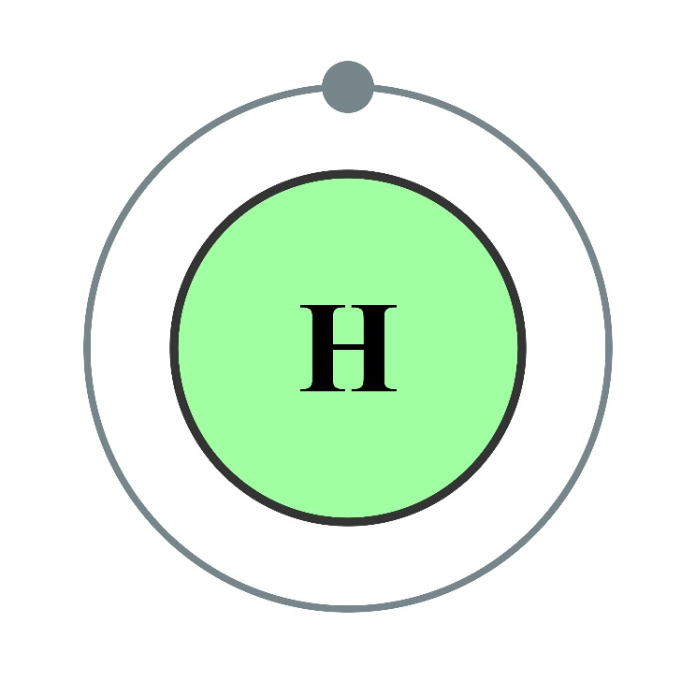
What’s next?
The development of:
UPHYMOB training & assessment materials
The trainer’s handbook
A guide to integrate UPHYMOB learning outcomes into current VET provision
Electron shell 001 Hydrogen licensed under CC BY-SA 2.0.

Slide 12
Working to support upskilling for H2 mobility
Foundation for the development of new Hydrogen technologies in Aragon, Spain
The Hellenic Society for the Promotion of Research & Development Methodologies, Greece
Instituto Superior Técnico, Portugal
San Valero foundation, Spain
Innovela sprl, Belgium

Slide 13
Upskilling the EU workforce for hydrogen fleets and infrastructure operation and maintenance Pr: No.:2021-1-ES01-KA220-VET-000028038
*Funded by the European Union. Views and opinions expressed are however those of the author(s) only and do not necessarily reflect those of the European Union or the European Education and Culture Executive Agency (EACEA). Neither the European Union nor EACEA can be held responsible for them.

